Slide 1

CG1112
Engineering Principles and Practices II for CEG
Week 4 Studio 1
Pre-Studio Briefing
colintan@nus.edu.sg

Slide 2
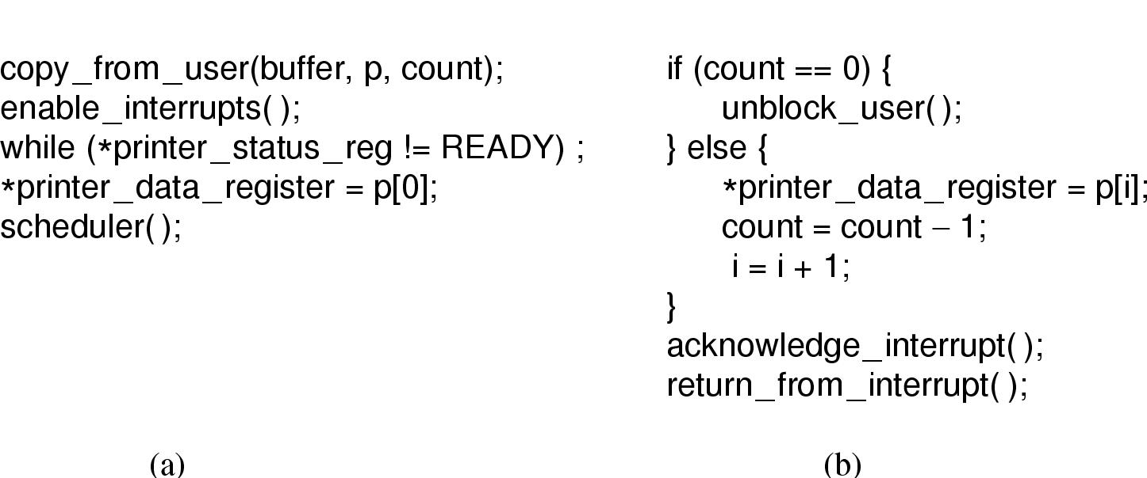
I/O Programming Interrupt I/O
Main Routine
Interrupt Service Routine (ISR)

Slide 3
Interrupt Programming on the Arduino Wiring Language
You can use attachInterrupt to specify an ISR to process interrupts.
The UNO can receive interrupts on pins 2 and 3 (INT0 and INT1).
attachInterrupt(digitalPinToInterrupt(pinnum),
function, mode)
pinnum: Either 2 (pin 2) or 3 (pin 3)
function: ISR to call when interrupt is triggered.
mode: LOW, CHANGE, RISING, FALLING.

Slide 4
Interrupt Programming on the Arduino Wiring Language
#define outputPin 13
// Interrupt 0 is on pin 2
#define inputInterrupt 0
volatile unsigned int data;
volatile unsigned char flag;
void setup()
{
pinMode(outputPin, OUTPUT);
attachInterrupt(digitalPinToInterrupt(
inputInterrupt), readAnalog,
CHANGE);
}
void readAnalog()
{
data=analogRead(0);
flag=1;
}
void loop()
{
while(1)
{
if(flag)
{
processData(data);
flag=0;
}
// Do other stuff
}
}
int main()
{
setup();
loop();
return 0;
}

Slide 5
Bare-metal AVR Interrupt Programming
You can handle an interrupt request by using the ISR macro:
ISR(vector)
{
ISR Code
}
The vector parameter specifies the interrupt you want to process.
It takes the form interruptName_vect
E.g. to handle the PCINT0 interrupt, you would specify PCINT0_vect in vector.

Slide 6
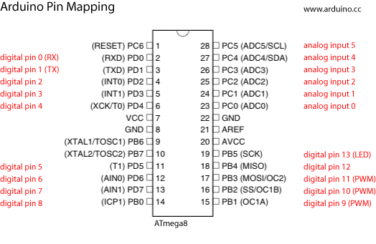
Bare-metal AVR Interrupt Programming
Arduino pins 2 and 3 are connected to INT0 and INT1, as shown in this diagram.
In the previous table, we can see that INT0 and INT1 are external interrupts.

Slide 7
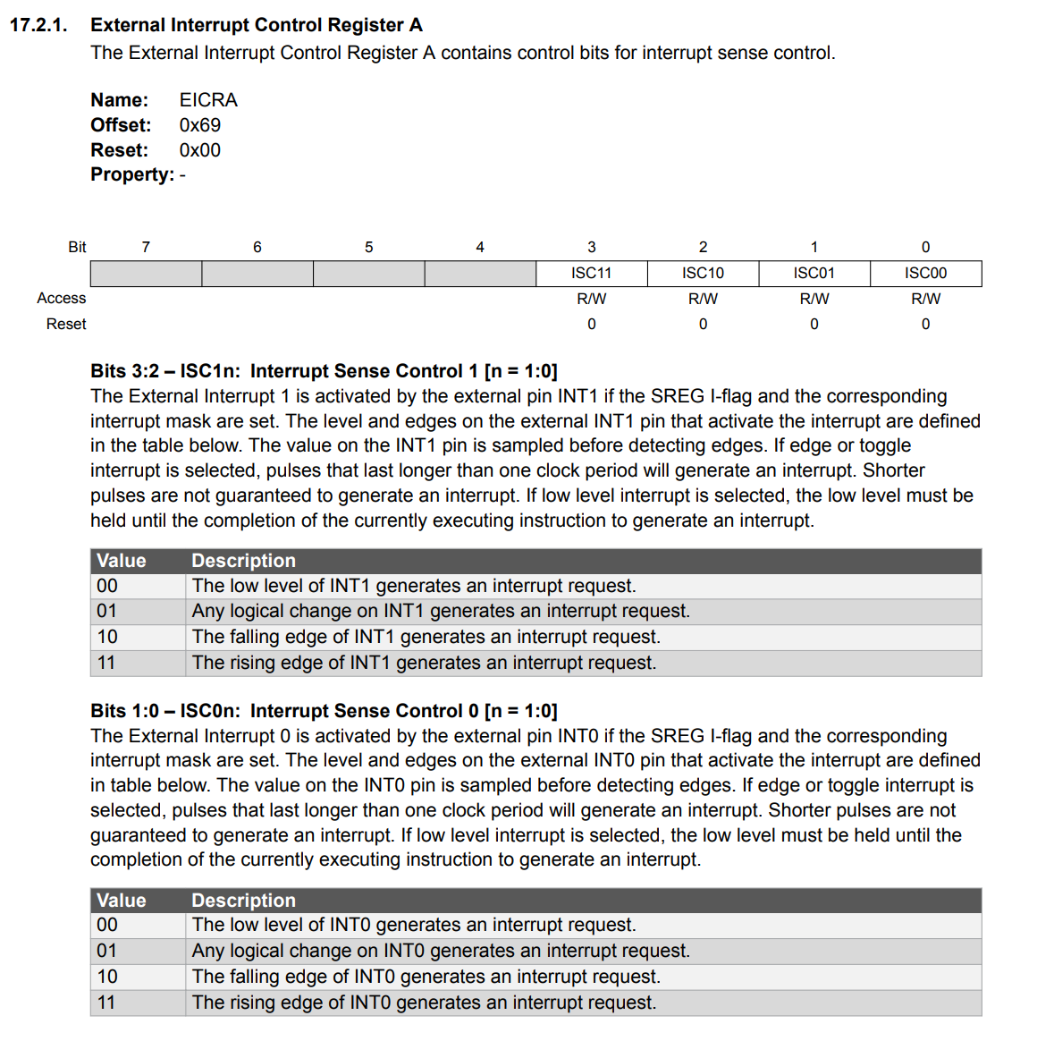
Bare-metal AVR Interrupt Programming
Both INT0 and INT1 can be configured in how they respond to interrupt requests:
This is done by settings bits 3 and 2 for INT1, and 1 and 0 for INT0 of the EICRA register, according to the table on the right.

Slide 8
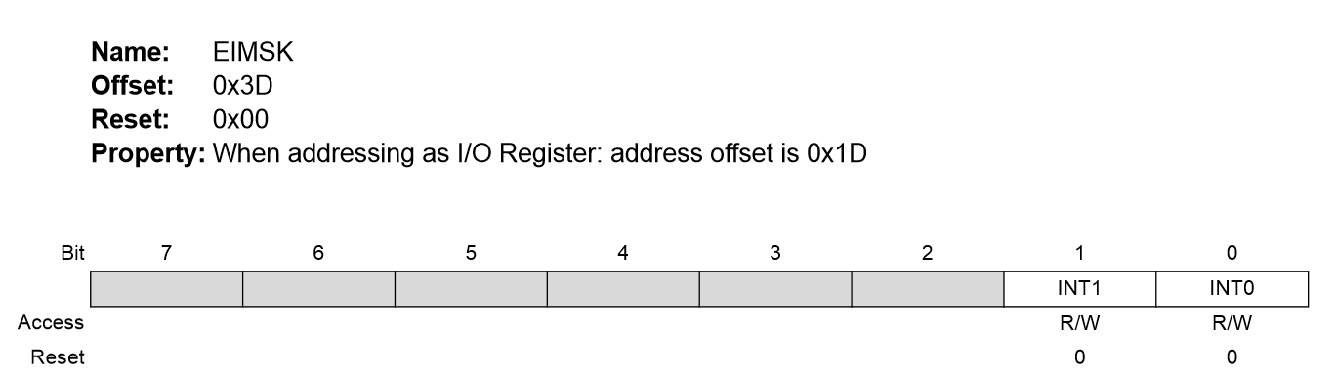
Bare-metal AVR Interrupt Programming
By default, INT0 and INT1 are turned off. To turn them on, you need to write to bits 0 and 1 respectively of register EIMSK (External Interrupt Mask Register):

Slide 9
Interrupt Masking
The MCU can be made to ignore almost all interrupts. This is called “interrupt masking”.
This is used in critical segments of code where any interruption can result in wrong execution.
How to disable/enable interrupts:
On Arduino Wiring Language:
noInterrupts() to disable all interrupts.
interrupts() to enable all interrupts again.
On bare-metal:
cli() to disable all interrupts.
sei() to enable all interrupts again.

Slide 10
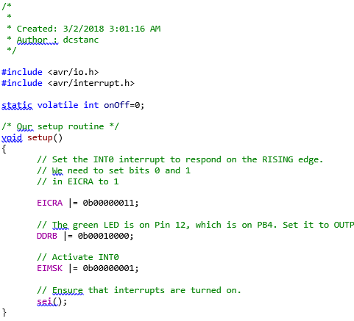
Bare-metal AVR Interrupt Programming
Example code in C: Using INT0 to switch and LED on and off.

Slide 11
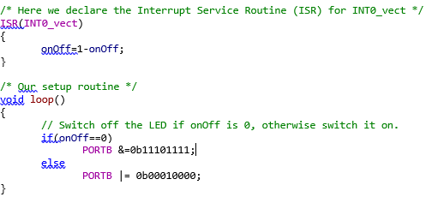
Bare-metal AVR Interrupt Programming

Slide 12
Being Volatile
For correct program operation, any global variable that is modified by an ISR but used by another function, must be declared to be “volatile”.
In our example onOff is set/cleared by the ISR but used in main, so we declare:
static volatile int onOff;
The “static” keyword is optional, and it prevents other C modules from accessing/modifying onOff, which it could otherwise do simple by declaring:
extern int onOff;

Slide 13
The Interrupts Studio
Three activities this week:
Activity 1: Reading a switch through polling.
Activity 2: Reading a switch through interrupts, using the Arduino library. We will also look at switch debouncing.
Activity 3: Doing bare-metal interrupt programming.

